Slide 1

IT SUPPORT TICKET MANAGEMENT SYSTEM ANALYSIS
Irman Sharma
19th December 2024

Slide 2
Problem statement
You are tasked with analyzing the IT support ticket management system to understand the performance of IT agents, the efficiency of ticket resolution, and the satisfaction levels of employees. The objective is to identify high and low performers among IT agents, assess the overall effectiveness of the team, and pinpoint areas for improvement in the ticket resolution process. The ultimate goal is to make informed staffing decisions, including hiring, firing, and training, to enhance overall service quality and team performance.
Some Objectives:
Identify agents that should be fired or trained.
Identify request categories to invest in to reduce ticket count and improve the efficiency of ticket resolution.
Compare priority and severity over the years.

Slide 3
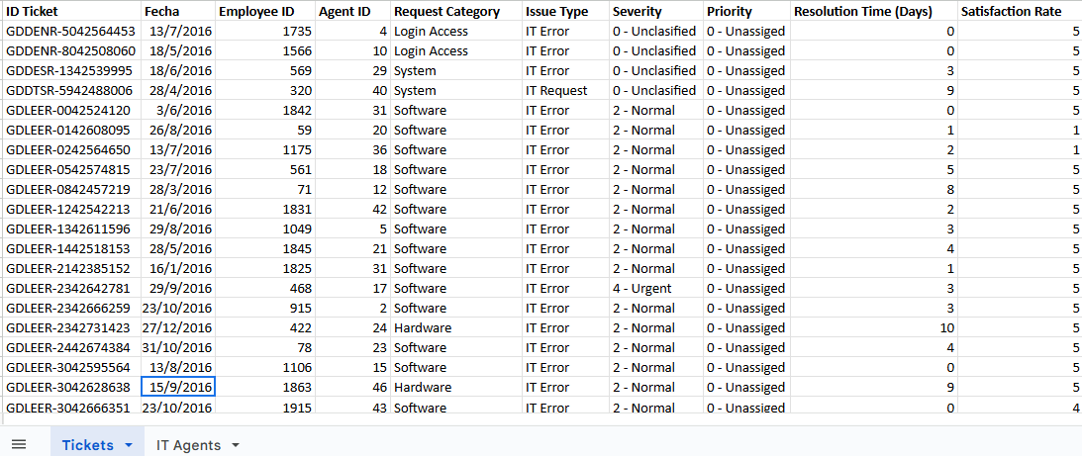
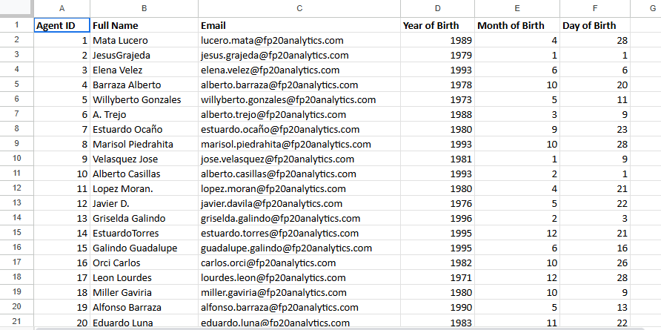
Dataset

Slide 4
Data summary
Key attributes:
ID Ticket: Identifier of the ticket. Useful in ticket count request category/agent wise
Fecha: Ticket date. Useful in tracking performance metrics over time.
Agent ID: ID of the agent assigned to the ticket. A very useful attribute to check attributes for each agent. For example, average satisfaction rate or average resolution time for each agent
Request Category: (Login Access, System, Software). Helps in understanding metrics for each category, so we get a better understanding of where to invest.
Severity: Issue severity. Comparison of issue severity with priority gives us important insights
Priority: Priority level of the issue. Comparison with severity gives us important insights

Slide 5
Data summary (continued)
Key attributes (continued):
Resolution Time (Days): Days taken for ticket resolution. A very important metric, because the number of days taken is a key indicator of performance
Satisfaction Rate: Satisfaction level provided by the employee. A direct indicator of performance.
Full Name: Full name of the IT agent.
Procedure to find inconsistent values: Filter from “Sort and Filter” to reveal all the values from each column. Manuel checking of the values from each column for inconsistencies. There are no inconsistencies in the data set.
Formula to count missing values: =COUNTBLANK(A1:J97499)+COUNTBLANK(Sheet2!A1:F51).
There are 0 missing values in the dataset.
Also, there are no duplicates in the dataset (“Remove Duplicates” was used)

Slide 6
Methodology
Analytical Methods and Tools used:
Data Cleaning: Checking for missing values, inconsistencies and duplicates. Checked missing values using “=COUNTBLANK(A1:J97499)+COUNTBLANK(Sheet2!A1:F51)”, inconsistencies using manual checking with “Filter” where all the values were revealed for only one time, and duplicates using “Remove Duplicates.”
Aggregate Functions: Functions like average, correlation were used to get a better understanding of the data. For example, average function was used to find the average of resolution time.
Pivot Tables and charts: Were crucial in helping understand important metrics like average satisfaction rating provided by each agent, and a lot more. The charts helped us perform trend analysis like performance over time, and statistical analysis like average resolution time per category.
VLOOKUP FUNCTION: We used the function to extract the full names of agents from one sheet to another (with all the important attributes).

Slide 7
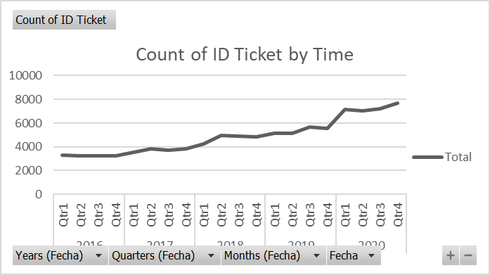
Ticket count by time
Observations:
The count of ticket over time has increased.
This can be good because more tickets are being resolved.
But this can be bad too, because maybe increased count of ticket means increase in problems.

Slide 8
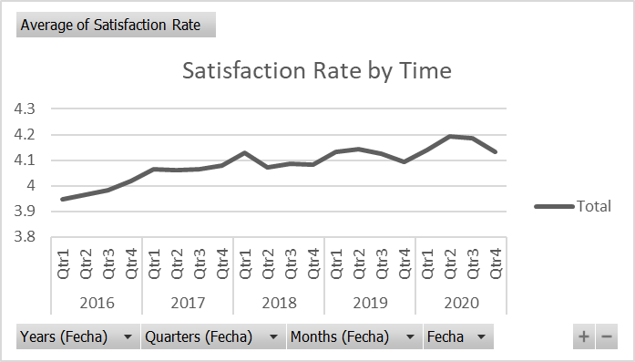
Average satisfaction rate by time
Observations:
The average satisfaction rate has increased over time, which shows the efficiency of the ticket resolution system has increased.

Slide 9
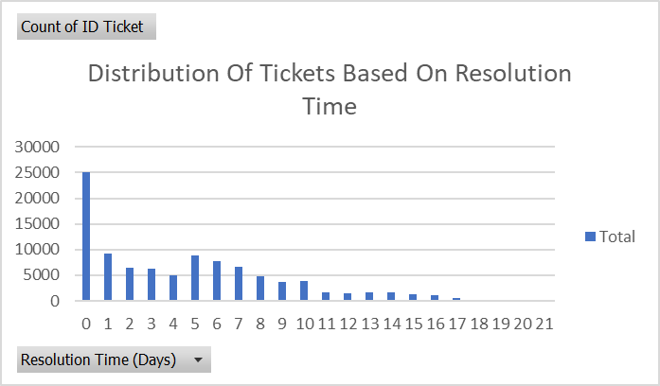
Number of tickets based on resolution time
Observations:
Majority of the tickets were resolved in less that 1 day, which means the resolution speed is good.
The chart seem alright. However, 5 days, 6 days and 7 days have relatively high number of tickets which is problematic

Slide 10
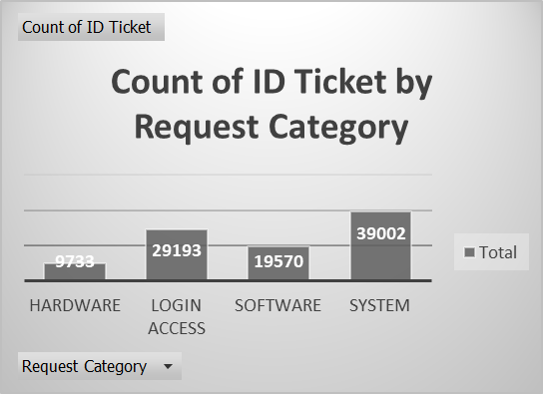
Number of tickets based on request category
Observations:
System has the largest ticket share, followed by login access.
The ticket share of hardware is relatively low.

Slide 11
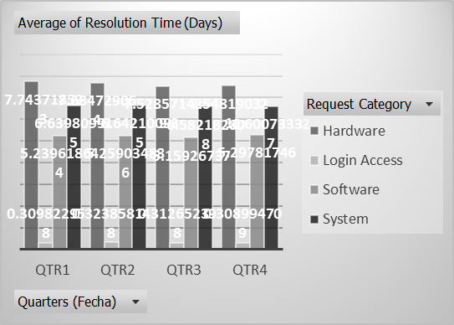
Average resolution time by category (quarter wise)
Observations:
The structure is similar throughout the quarters, with Login Access taking the least time, and Hardware taking the most.

Slide 12
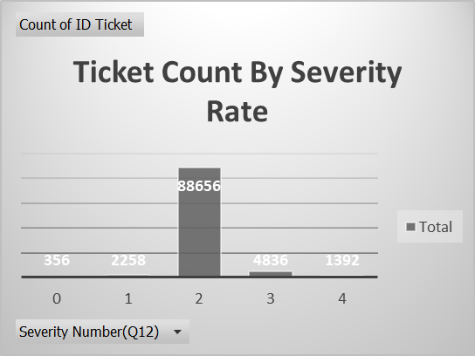
Number of tickets based on severity rate
Observation:
Severity Rate 2 has the highest number of tickets.
Severity Rate 0 has the least number of tickets, which is not a favorable scenario.

Slide 13
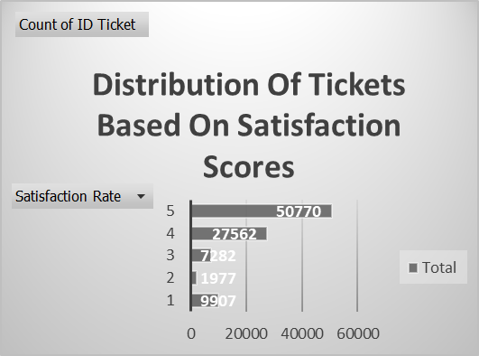
Ticket count based on satisfaction scores
Observations:
Satisfaction Score 5 has the highest number of tickets, which is great.
Satisfaction Rate 1 has more tickets than 2 and 3, which is not favorable.

Slide 14
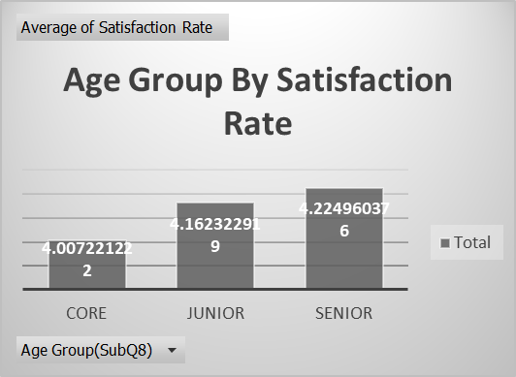
Age group by satisfaction rate
Observations:
Senior agents have higher satisfaction score on average.
However, the difference is not that significant.

Slide 15
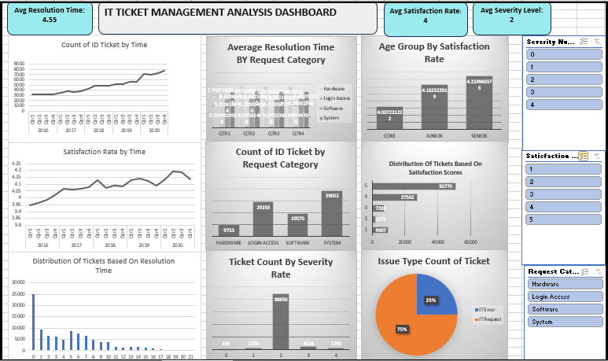
dashboard

Slide 16
Recommendations
There should be quality checks for hardware or investment in new hardware because the current hardware issues take a long time to get resolved on average.
Software and Systems should also be examined because they have high resolution time on average as well.
Invest in training: Invest in training of agents with average satisfaction rates less than 4. Also invest in training of agents with average time of resolution more than 4. Also, the grand total of ratio of average satisfaction rating and average resolution time is 0.9. Agents with the ratio less than 0.9 should be given training.
The current software tools are not as effective in managing tickets as desired based on the comparison of priority and severity levels. Investments should be made in improving them or new tools should be implemented.

Slide 17
conclusion
By using the insights and recommendations provided in this presentation, the IT ticket management system can be more efficient.
The system is efficient enough. However, there is room for improvement.

